Slide 1
Economic consequences of slower population growth and faster aging: Will there be a Great Demographic Reversal?
Ronald Lee, Demography and Economics, Univ of California at Berkeley
rlee@demog.berkeley.edu
IGIER Policy Seminar on the Great Demographic Reversal
Bocconi University
Deep thanks to all NTA teams and to Andrew Mason and Gretchen Donehower

Slide 2
Not a critique of Great Reversal, but rather looking at some similar issues from different perspective.
I will say nothing about inflation
I focus on fundamentals and direct consequences of demographic change.

Slide 3
1. The “demographic transition” in a population unfolds over a couple of centuries

Slide 4
A population moves from many births and short life to low fertility and long life.
These changes bring changes in the population age distribution, the shares in the pop of children, working ages, and the elderly.
In mid transition, the share in working ages rises boosting the growth rate of per capita income: the “demographic dividend”.
Later in the transition, the share of elderly rises reducing the growth rate of per capita income and stressing societal support systems: costs of population aging.

Slide 5
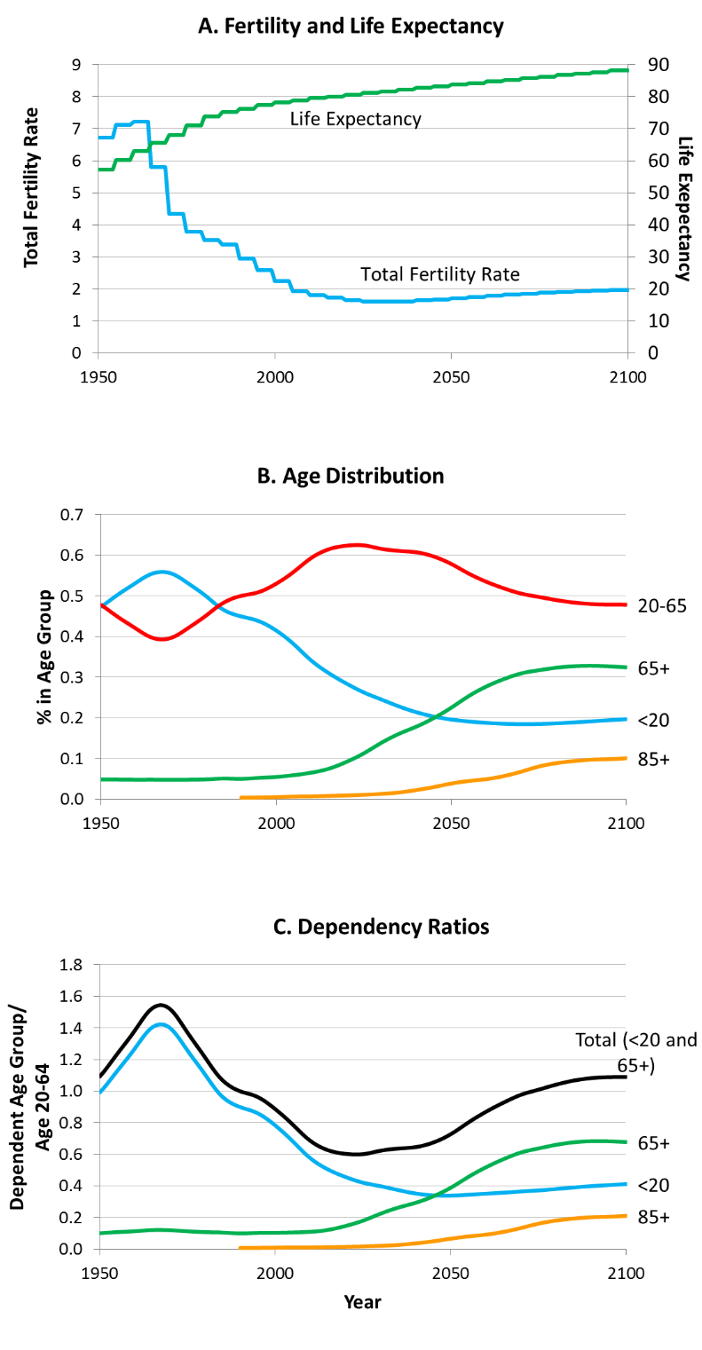
A typical demographic Transition: Costa Rica, 1950-2100.
Youth Dep Ratio
Old Age Dep Ratio

Slide 6
2. What are the economic consequences of these changes? First, global GDP.
Use age profiles from National Transfer Accounts.
Labor inc = wages and salaries + 2/3*self employment inc
Averaged across males, females, and zeros
Consumption = household cons imputed to individuals + in-kind govt transfers like public education, public health care, long term care.

Slide 7
Average per capita labour income by age for countries by income group
(expressed for each country as ratio to average labour income ages 30-49, 160 countries)
Source: Figure 1 in United Nations
Department of Economic and Social Affairs Population Division,
Technical Paper No. 2017/1
“Support Ratios and Demographic
Dividends: Estimates for the World”

Slide 8
Use these to find effect of population on global GDP
Calculate “effective labor” in ppp adjusted monetary units for each of 186 countries
  Multiply pop age distribution times NTA labor income age profile and sum.
  Do for past, present and future UN pop data.
  Gives total labor income in each year if only demography varies
Add these up across all countries to get global labor income estimate net of productivity growth. Just demography.
  Reflects demographic change in each country
  Reflects productivity differences across countries.
Assume labor income is fixed share of GDP (not quite true).

Slide 9
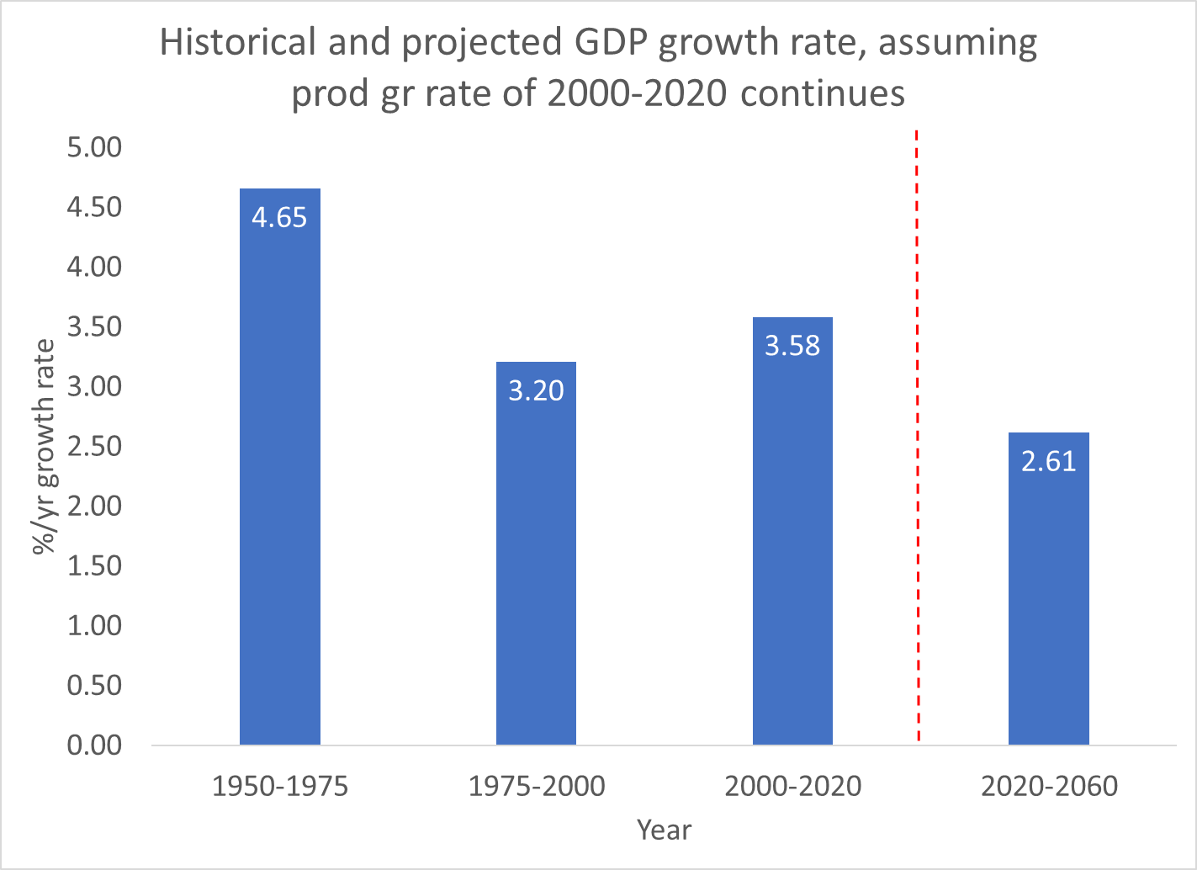
From Maddison, World Bank etc.
Then our projection.

Slide 10
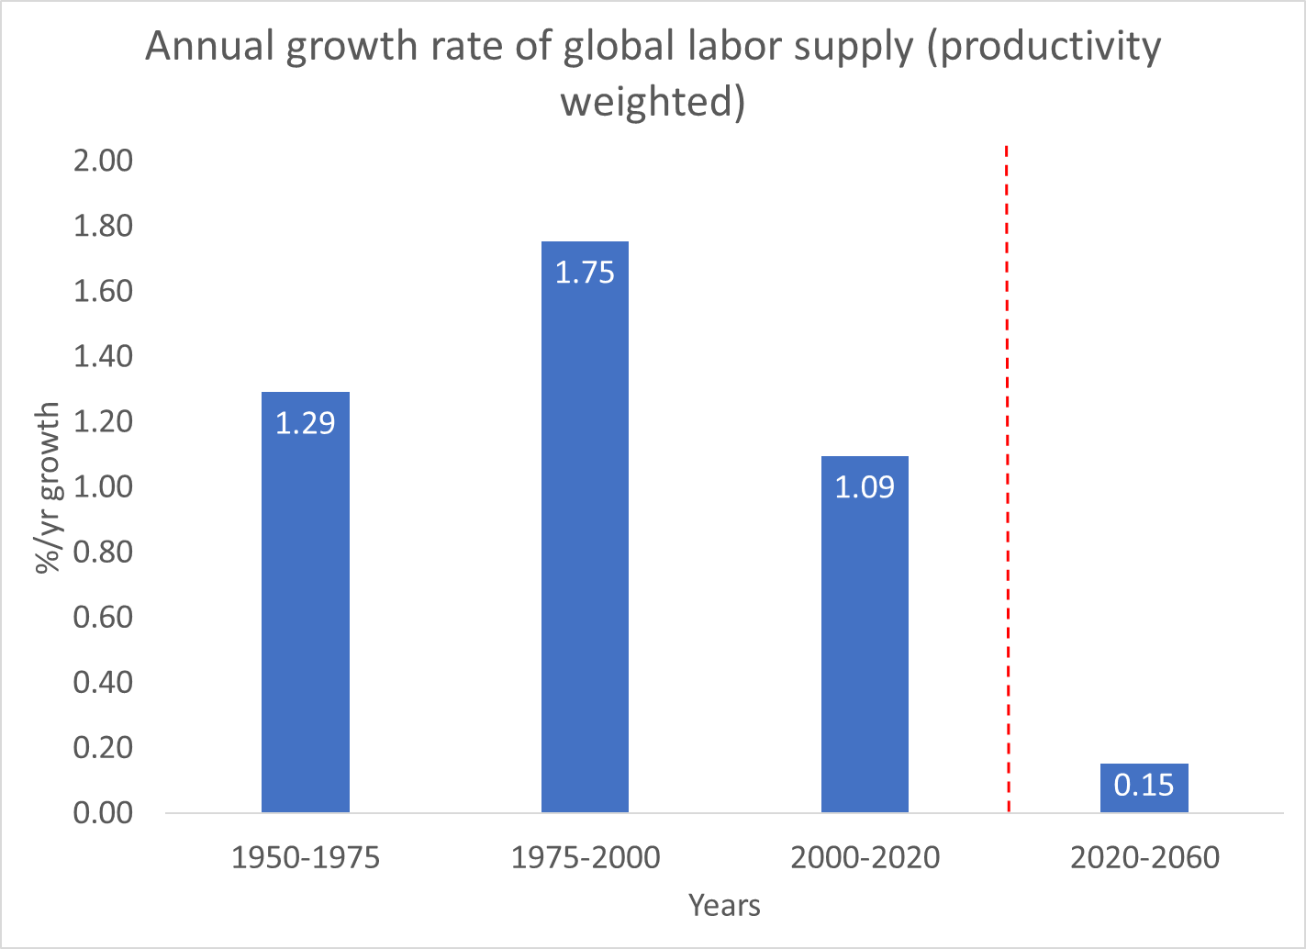

Slide 11
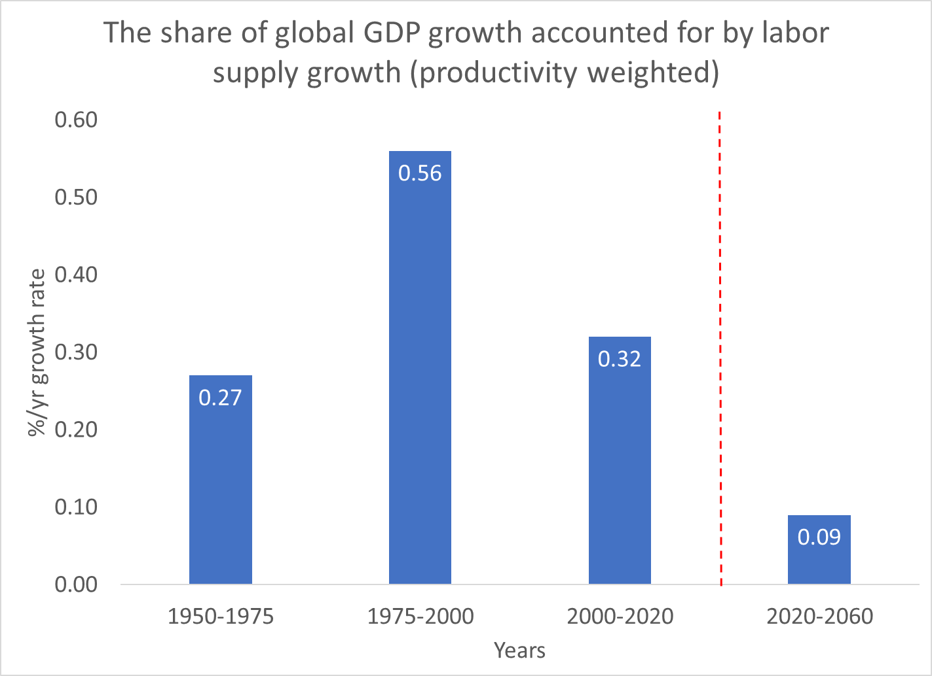

Slide 12
Era of population driven global GDP growth is over!
Why does growth rate of global labor supply drop so low (to .15%/y)?
Rapid labor growth is occurring in Sub-Saharan Africa, but productivity is very low so it has little impact on global GDP growth.
Slow or negative labor growth is occurring in high productivity countries (Europe, N. America, E. Asia, etc.) with big impact on GDP growth.
Share of population in driving GDP growth drops from more than half in 1975-2000 to less than a tenth in 2020-2060.

Slide 13
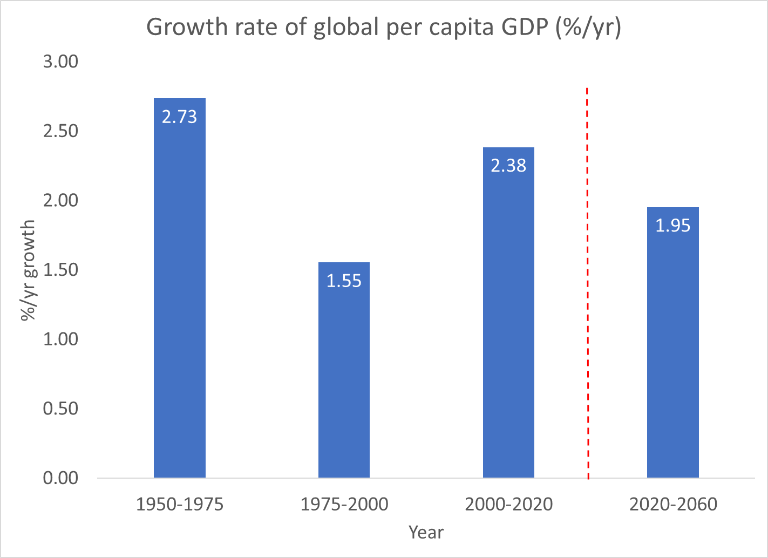

Slide 14
Per capita GDP growth will be much less affected.
Relative to 1975-2000 it will grow .4%/y faster in 2020-2060.

Slide 15
3. Most worries about pop aging are due not to the production side, but to redistribution
Age profile of labor income very different than profile of consumption.
Children and elderly consume much more than they produce.
Assets and asset income helps support the elderly, but
In most countries, public transfers fill most of the gap
  Public pensions
  Public health care
  Public long term care
For children, public education and public health care are most impt.

Slide 16
Average per capita consumption by age for countries by income group
(expressed for each country as ratio to average labour income ages 30-49, 160 countries)
Source: Figure 2 in United Nations
Department of Economic and Social Affairs Population Division,
Technical Paper No. 2017/1
“Support Ratios and Demographic
Dividends: Estimates for the World”
Per capita consumption by age, for income groups.
Includes both private household cons and in-kind public transfers (health, education)

Slide 17
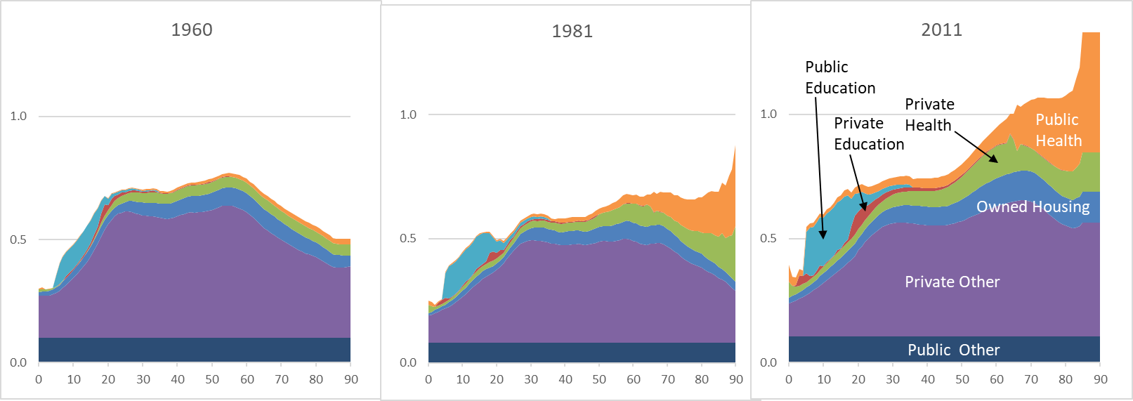
Age profiles change over time
*Below, US consumption rises dramatically at older ages in last half century.
*In most High Inc countries, labor income declined at older ages 1900-1995 (earlier retirement)
Small upturn since then.

Slide 18
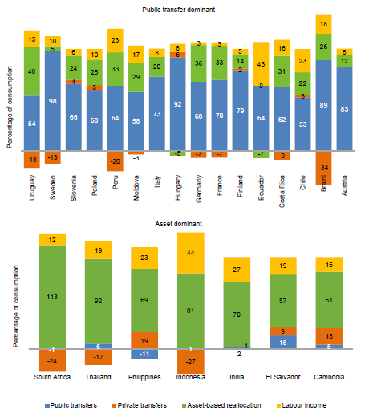
From United Nations, World Population Aging (Highlights), 2019, using NTA data
Funding old age consumption in % (65+)
Labor inc
Assets
Public transfrs
Private transfrs
Upper panel mostly public transfers. (Europe and Latin America)
Little labor inc, e.g. France and Germany 3%
Lower panel mostly assets (S.E. Asia, US, Mexico).

Slide 19
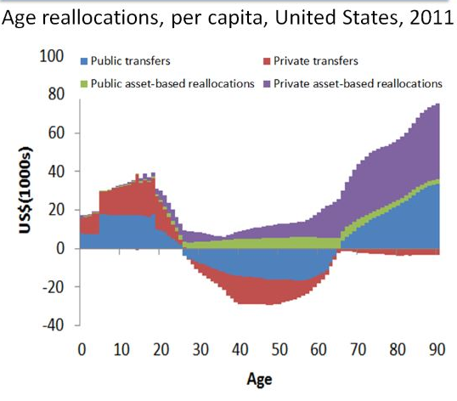
How the gap between consumption and labor income at each age was made up in US, 2011 (NTA)
Asset inc - svg
Public transfers
Pub net borrowing
Priv transfers

Slide 20
Why is this a concern?
When a population ages there are more elderly consuming more than they produce, and fewer workers producing more than they consume.
Something has to give – either workers make bigger transfers (e.g. with higher taxes) or elderly receive smaller benefits (e.g. lower pension or later retirement).
This is the main concern with population aging.

Slide 21
Support ratio is simplest approach, reflecting dependency
Calculate ratio of available workers to needed consumption.
Assume
  NTA labor income describes available labor at each age, in efficiency units
  NTA consumption describes consumption needs at each age.
  productivity growth raises both age profiles over time in same way, so their ratios are unchanging.
Now calculate support ratios over time.

Slide 22
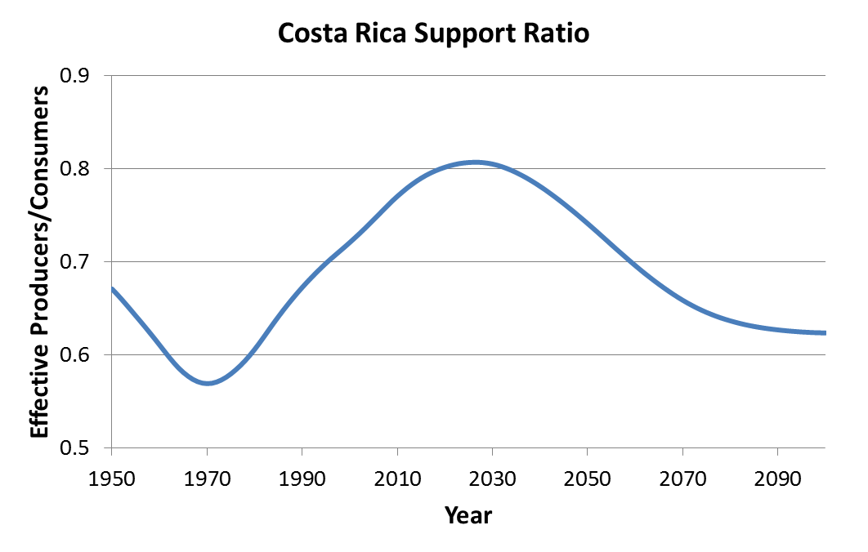
Support Ratio = ratio of Potential workers to potential consumers
Decrease = -.4%/yr
Pop aging
Increase = .7%/yr
“first dividend”
Contrast = 1.1%
Based on UN pop data and forecasts, and estimated consumption and labor income age profiles for Costa Rica by Costa Rican country team, led by Luis Rosero-Bixby.

Slide 23
General shape of transition trajectory is standard.
Details differ across countries because of:
*Rapidity and depth of fertility decline
*Baby booms and busts superimposed.
Position of some pops on demog transition today.
China
India
Hi Inc
Niger
Based on UN pop data and forecasts, and estimated consumption and labor income age profiles for Costa Rica by Costa Rican country team, led by Luis Rosero-Bixby.

Slide 24
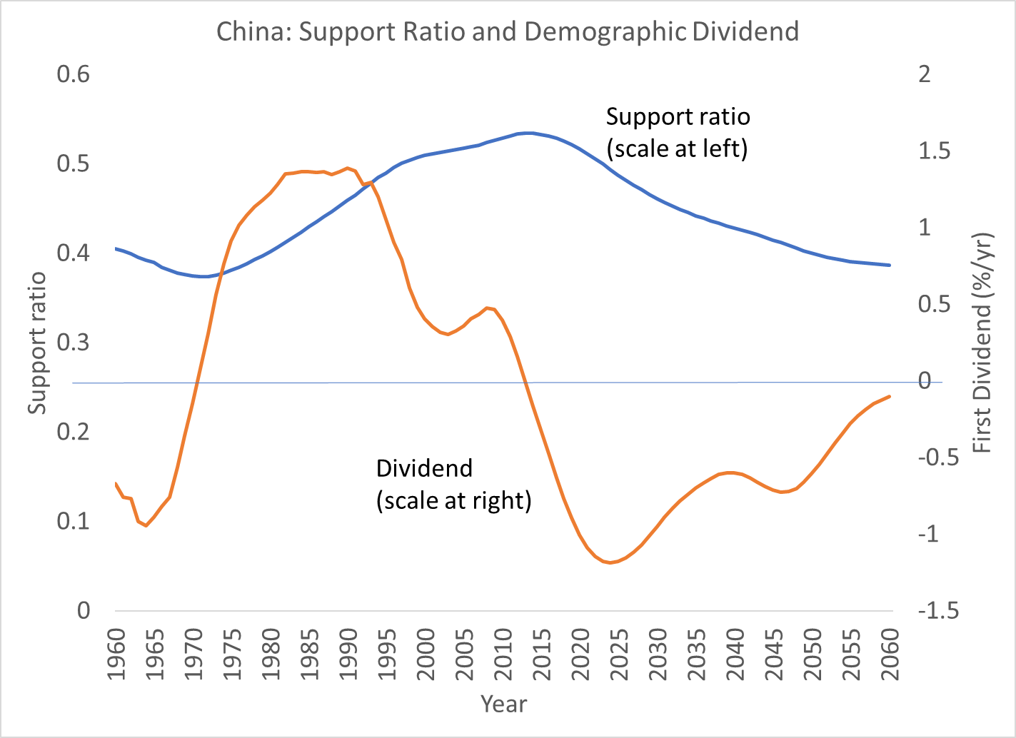
A “Great Demographic Reversal” -- Support ratio in China
Rises from 1971 to 2013.
Falls fast after 2013.
Av 1981-90 rises at 1.36%/y
Av 1920-29 fall at 1.11
Diff is about 2.5%/y in growth of income per equiv consumer
A huge economic shock.
Dividend is rate of change of supp ratio

Slide 25
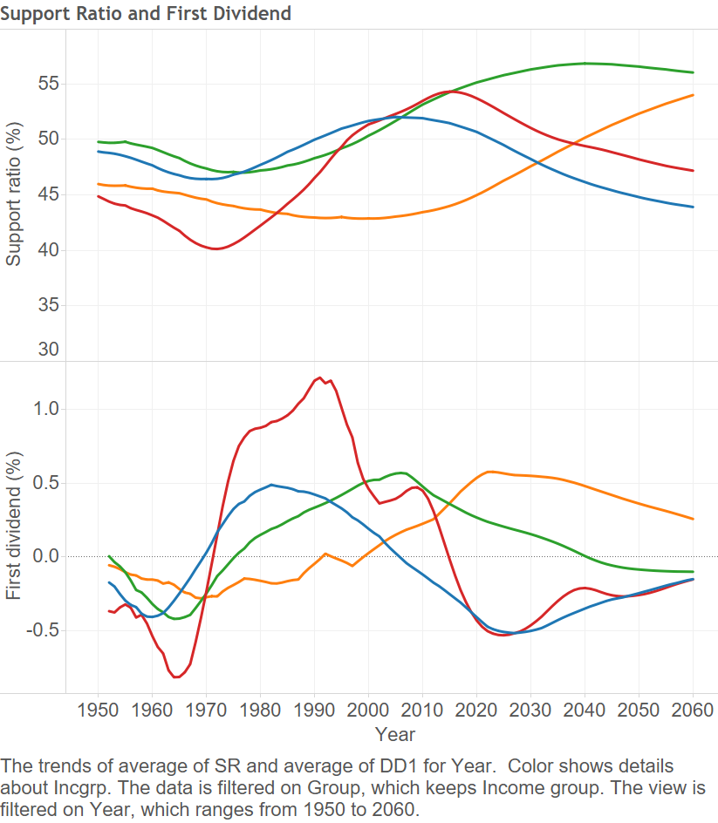
Great Reversal? Maybe. Less clear.
On global scale, supp ratio stops rising around now.
But Hi Inc countries have been aging for awhile.
Low Inc and Lower Mid Inc countries still in dividend phase.
Support Ratio
Low-Mid Inc
Low-Inc
High Inc
Up-Mid Inc
Demog Div = change in Supp Rat
Up-Mid Inc
Low-Inc
Low-Mid Inc
High Inc

Slide 26
7. Taking capital into account

Slide 27
Support ratio and Demographic Dividend are widely used concepts and measures
But not all income comes from labor; a third comes from capital.
Working age folks bring labor to the economy.
Elderly in most countries bring capital to the economy.
  Asset (capital income) can pay for their old age consumption so they are not dependent on workers.
  More capital raises the productivity and wages of workers (if invested domestically).

Slide 28
How does pop age distrib affect amount of capital?
Asset holdings by age are accumulated through saving, but also by inheritance, taxation, and changing relative asset prices (e.g. housing market, stock prices).
All these are reflected in NTA asset age profiles.
Because elderly have accumulated the most capital, population aging increases the amount of capital relative to labor (if normal life cycle patterns continue).

Slide 29
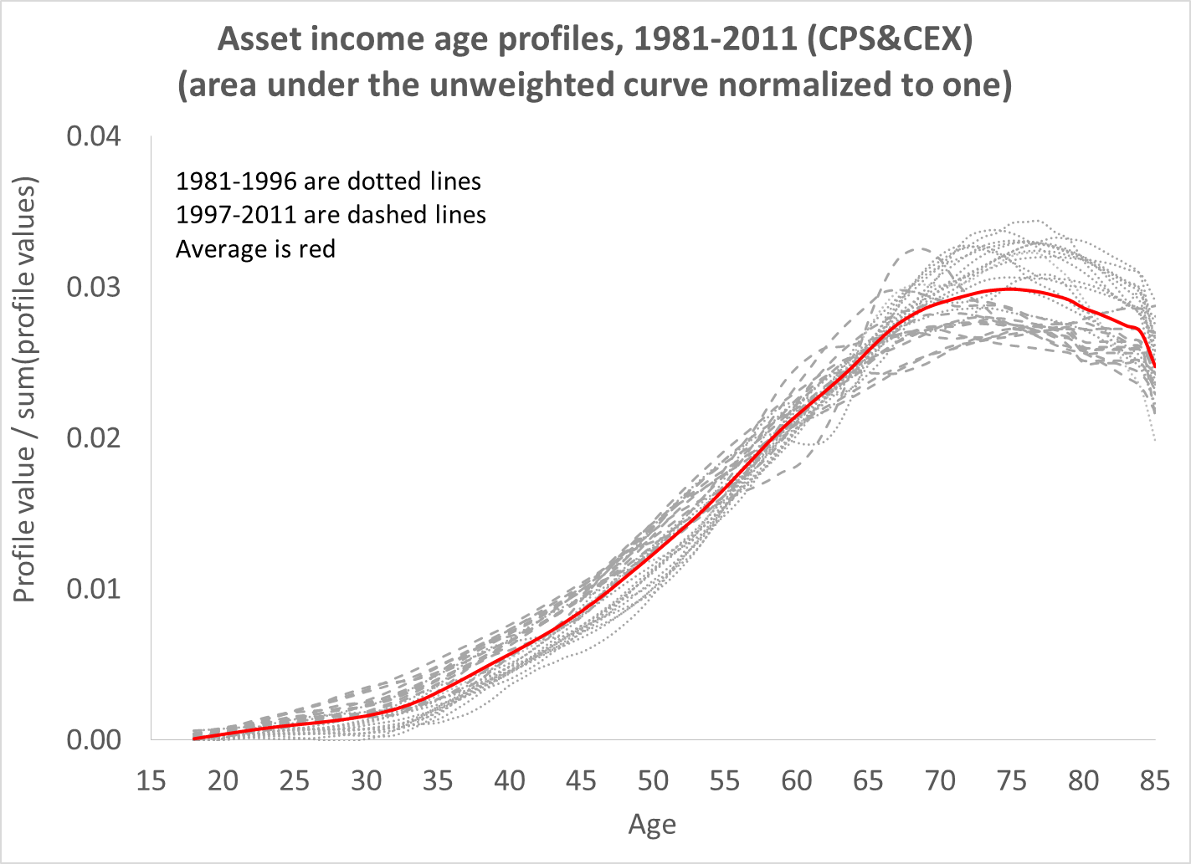
Example for US: standardized asset income from 1981-2011
Assets held mainly by elderly, 60+

Slide 30
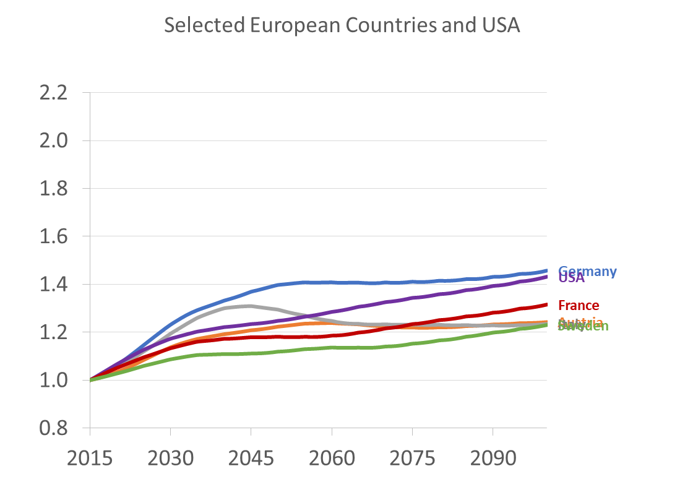
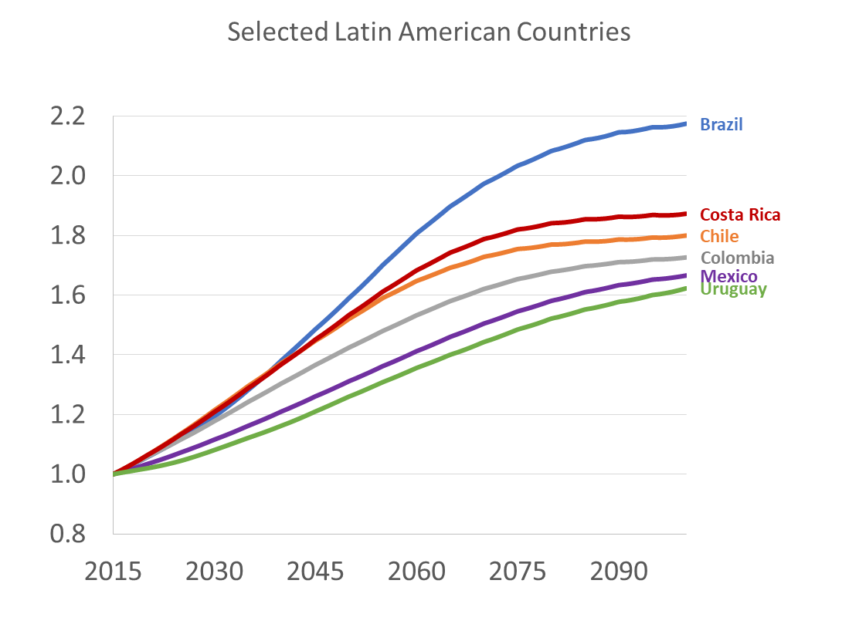
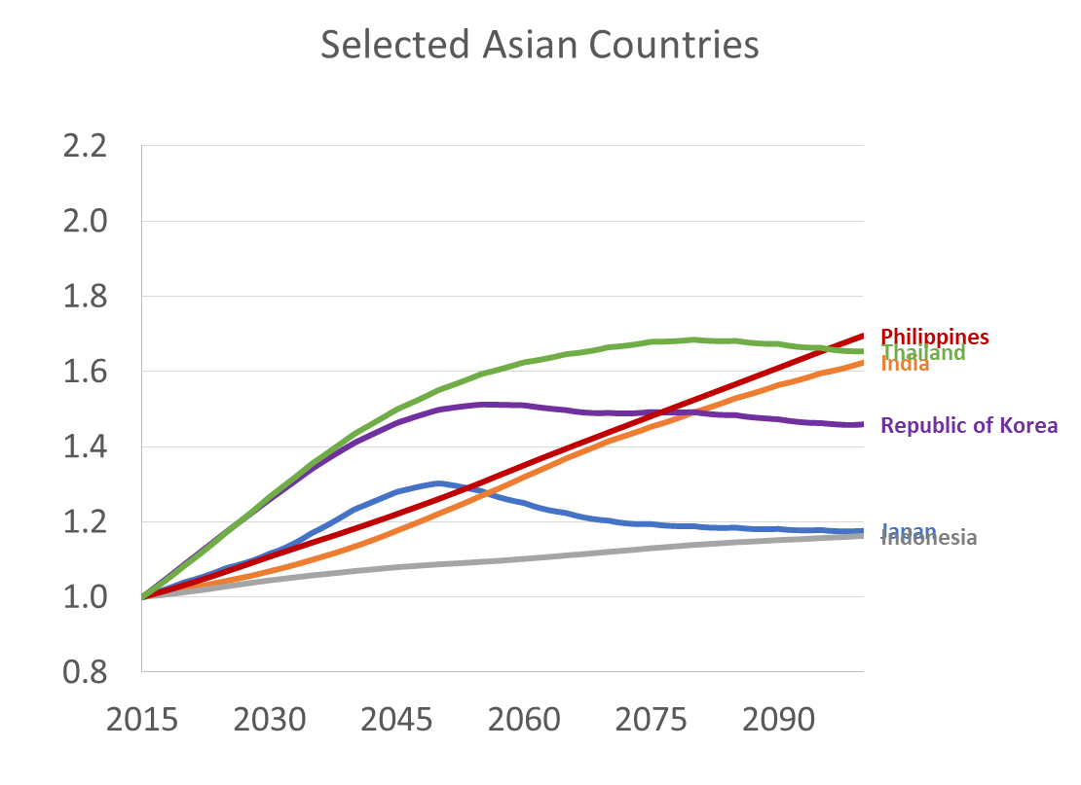
For closed economy, simulated ratios of capital to labor (K/L) and also Wage to Interest Rate (w/r) relative to 2015 = 1.0 for both based on NTA data, assuming Cobb-Douglas production function.
Europe & US
Latin America
Asia
Brazil
Philippines, India, Thailand
Chile, Costa Rica
Germany, US
Mexico, Uruguay
Sweden, Austria, Italy
Japan, Indonesiab
When pop aging raises capital more than labor, the “capital intensity” of economy rises.
Labor productivity and wages rise, interest rate falls.
Countries with biggest increases in K/L are earlier in demographic transition.

Slide 31
From preceding I expect
Rising real wages (more capital per worker)
Higher productivity (more capital per worker) and probably increased international capital flows
Lower interest rates (less labor per capital)
Above should reduce income inequality.

Slide 32
8. Discussion/Conclusions
China reached a real demographic “Reversal” (in 2013 for Support Ratio) slowing growth of GDP and income per consumer in China.
Rest of world’s population is mix
  low inc countries benefit from demographic dividends
  high inc countries see costs of continuing population aging.
Relative to 1975-2000, future population change slows global GDP growth by 1.6%/y. But per capita GDP will grow somewhat more rapidly.
Interest rates will continue to fall as more elderly bring more assets.
Real wages will rise due to more capital per worker in addition to technological progress.
Higher real wages and lower returns to capital should reduce income inequality.

Slide 33
END

